Slide 1
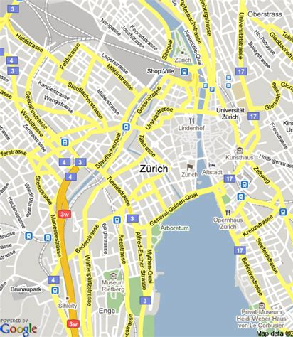
The 15-Minute City in Practice Comparing Theoretical Accessibility and Actual Mobility Behavior in Zurich
Lucie Kern and Noémie Simon
Patterns and Trends in Environmental Data
03.06.2026

Slide 2
Context
What is a 15-minute city ?
🏠 🛒🎓 💼🌳 🍽️ 🚉 🏥
A city where residents can meet most of their everyday needs within a 15-minute walk or bike ride from their home, reducing dependence on cars and improving urban sustainability and quality of life.
Application Area
Conceptual Model
Data Structure and Availability
urban planning
mobility analysis
accessibility
Activity Space
Space - Time Prism
Individual Mobility Data
Google timeline
Urban context Data
OpenStreetMap
Moreno, C., Allam, Z., Chabaud, D., Gall, C., & Pratlong, F. (2021). Introducing the “15-Minute City”: Sustainability, resilience and place identity in future post-pandemic cities. Smart Cities, 4(1), 93–111. https://doi.org/10.3390/smartcities4010006

Slide 3
Presentation general of the project
We compare theoretical accessibility with actual mobility behavior
Case study: one individual living in Zurich
Data: Google Timeline GPS trajectories over 3 months
Context data: Points of Interest and transport infrastructure
Main focus: identifying mismatches between:
nearby available services
15-minute accessibility areas
daily travel patterns
Goal: understand whether accessible infrastructure is actually reflected in everyday mobility behavior.

Slide 4
Context & Project Intro
What is a 15-minute city ?
🏠 🛒🎓 💼🌳 🍽️ 🚉 🏥
A city where residents can meet most of their everyday needs within a 15-minute walk or bike ride from their home, reducing dependence on cars and improving urban sustainability and quality of life.
Application Area
Conceptual Model
Data
urban planning
mobility analysis
accessibility
We use activity space to compare theoretical accessibility with actual mobility behavior based on the data collected from one individual living in Zurich
Google timeline for individual mobility
OpenStreetMap for Points of Interest and transport infrastructure for urban context
Goal
understand whether accessible infrastructure is actually reflected in everyday mobility behavior
Moreno, C., Allam, Z., Chabaud, D., Gall, C., & Pratlong, F. (2021). Introducing the “15-Minute City”: Sustainability, resilience and place identity in future post-pandemic cities. Smart Cities, 4(1), 93–111. https://doi.org/10.3390/smartcities4010006

Slide 5
Research questions
1. What share of daily activities occurs within 15 minutes from home ? (per means of transportation)
2. How does actual mobility differ from the theoretical accessibility?
3. Which types of activities most often occur beyond a 15‑minute radius?

Slide 6
Best Possible Outcome
We expect to:
Quantify the proportion of local vs non-local activities
Identify activity types that exceed the 15-minute threshold
Evaluate whether mobility is driven more by accessibility or by personal preferences and habits
Hypothesis: Even in Zurich, many social and professional activities
occur beyond the theoretically accessible area

Slide 7
Research plan
Collection of data of trajectory (google maps)
Creation of isochrones (15-minute accesibility zones)
Detection of point of interests (POI)
Preprocessing of collected data (segmentation, categorization of visited points, mobility shapes)
Join both maps
Analysis and computation of theoretical accessibility and practical mobility
Results visualisation

Slide 8
Preliminary results

Slide 9
Challenges and Plan B
Integration of the ZVV time plan
Heavy data set
Add unusefull complication
Use an estimation of the speed of the public transports (bus and tram) of 15 km/h
Anonymisation of the data
With only a few visited points, it is possible to find out where the person lives/who they are
→ Change the adress by a few blocks/streets (but still not ideal)

